Slide 1


Enterprise Communication and Notification System
YOUR LOGO HERE:

Slide 2

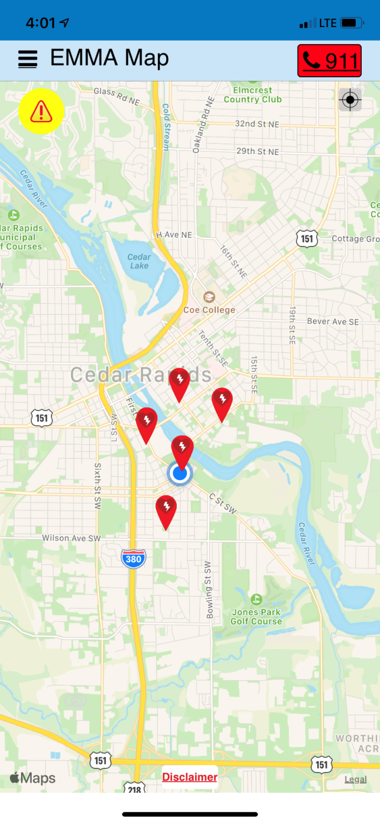

Developer Founded in 2000 that developed E.M.M.A.
Focused on “Pre-911 Space” Making Minutes Matter
Iowa DEMO fund technology award recipient
HQ in Cedar Rapids, IA
Sells through Dealers
E.M.M.A. Improved Safety Technology
  Emergency Management Mobile Application of 2020’s
  Education (K-12 and higher education)
  Utility Companies / Fleets & Mobile Employees
  Large Sq Ft / Large Employee Base Orgs
  Personal Safety

Slide 3


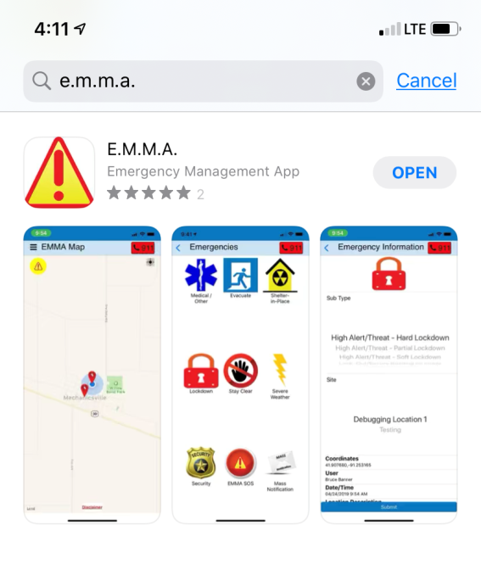
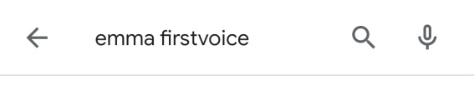
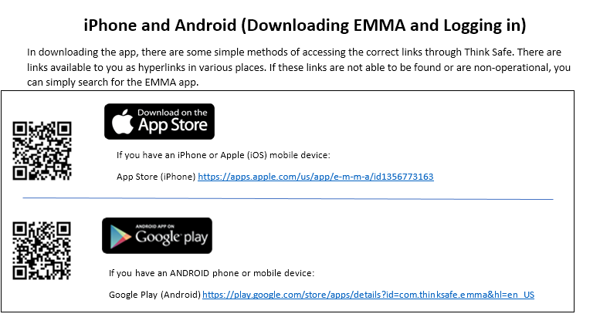


E.M.M.A. Free Download*
*Must be given a valid registration/code to use
QR Code for App Quick Find
However, organizations that use EMMA DO NOT have to mandate
That all users download EMMA – we have an email to SMS function
Built into EMMA that allows anyone on a “plan” to get the alert

Slide 4
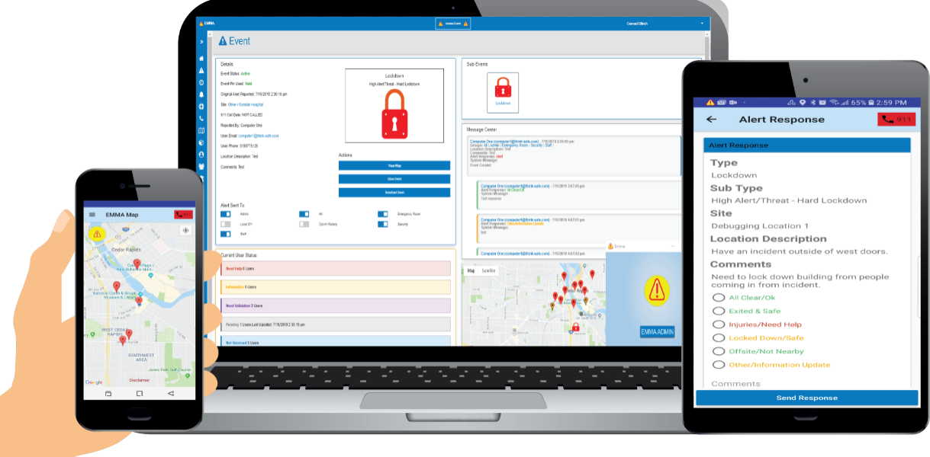
E.M.M.A. Features Summary
Mass Notifications via Push Notification, email….
Real Time 911 (Phone) CAD 911 Integration
Geofencing for Relevant Alerting in an Area
Anti-Bullying & S.S.S.S. Features
S.O.S. Personal Safety Feature
Pre-Scripted but Customizable Notifications
Integrates using EMMA API Programming SDKs
Cross Platform
Asset Mapping of Lifesaving Assets (GPS/GIS)

Slide 5
E.M.M.A. – 3 KEY FEATURES
Plus EMMA Provides 911 integration
Empowers Admin, Staff (and guests and 911 and others you want to notify) to report threats or emergency scenarios
Pocket tool for quick & accurate notifications/alerts (1st offering/feature)
Provides non-segmented communication during emergencies (2nd offering/feature)
Emergency Management Tool for imminent threats and emergencies (3rd offering/patent)
Personal, Family or Organizational preparedness including school safety
Reporting features and archives & 911 inclusion
Ala carte – can be customized very easily

Slide 6
Objectives of EMMA Presentation re:911
Show you how EMMA works – “reverse 911” application for awareness tied to geofencing (example – City of Cedar Rapids) the “call 911” button is key but also can text 911 for those incapable of talking on phone. This is an add-on to 911 existing systems and not a replacement. Low cost, public safety initiative.
2) Talk through the text to 911 technology and our solution / best way to
deliver the format
3) Talk through the format of the message – set a standard for common
protocol, if possible (see example)
Next slides: What is EMMA? (press play on slides for video)
(if you are not familiar with EMMA)

Slide 7
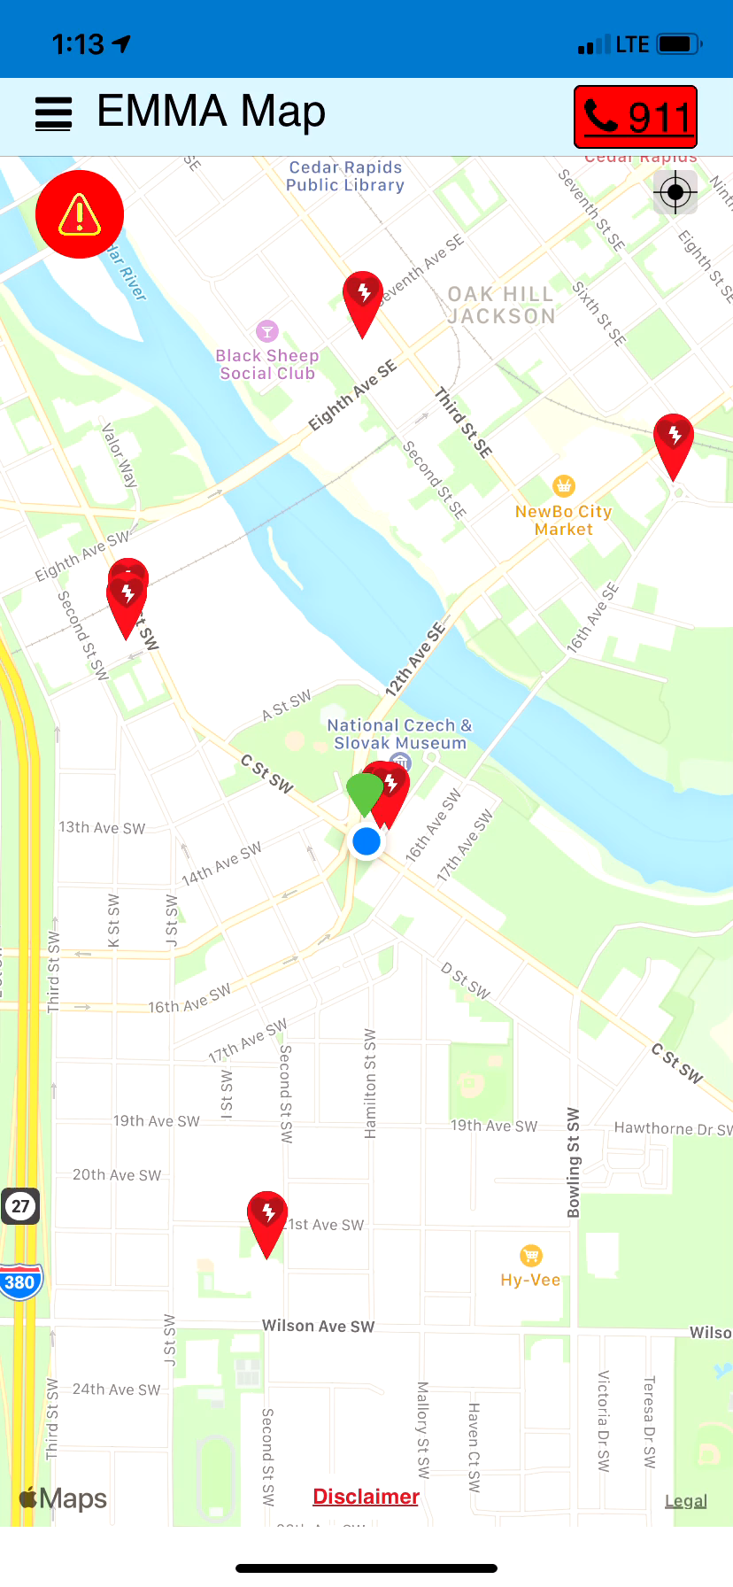
Quickly Call 911 While in EMMA &
Improve address info you give 911!
ENABLED 911
Must confirm twice to call
Latitude and longitude reporting is on 911 caller screen! HELPFUL! UNIQUE!
+Text 911 (we have API built that can text 911)
Data archives for analysis by organization for high risk areas or high risk users

Slide 8
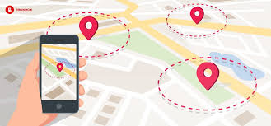
GPS Technology
Digital perimeter (events, locations, GPS enabled)
Based on latitude and longitude coordinates
Very relevant alerts can be sent to users in an impacted area
Pertinent messages to pertinent people
i.e. – community events (parade routes, farmer’s market, fairgrounds, etc)
Absent persons not in geofenced area won’t get alerts
Transient admins receive pertinent messages
Can build a radius around +/- & provide notice to those coming into an area that an alert impacts them
            We have continual EMMA Feed that allows seeing live stream with appropriate viewing privileges to users

Slide 9
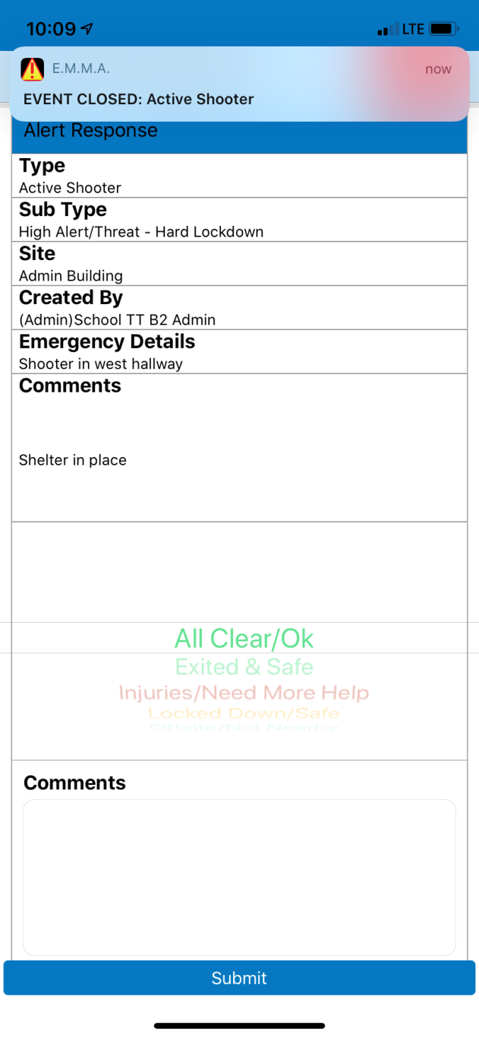
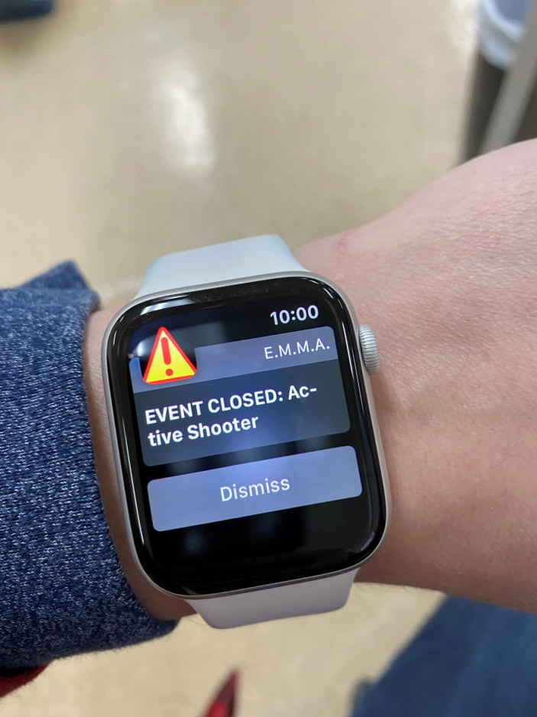
EMMA Notifications work with:
ANY connected (wifi or cell or network) device – PC, watch, phone, ipad, chrome book, laptop, Smart TV, etc

Slide 10
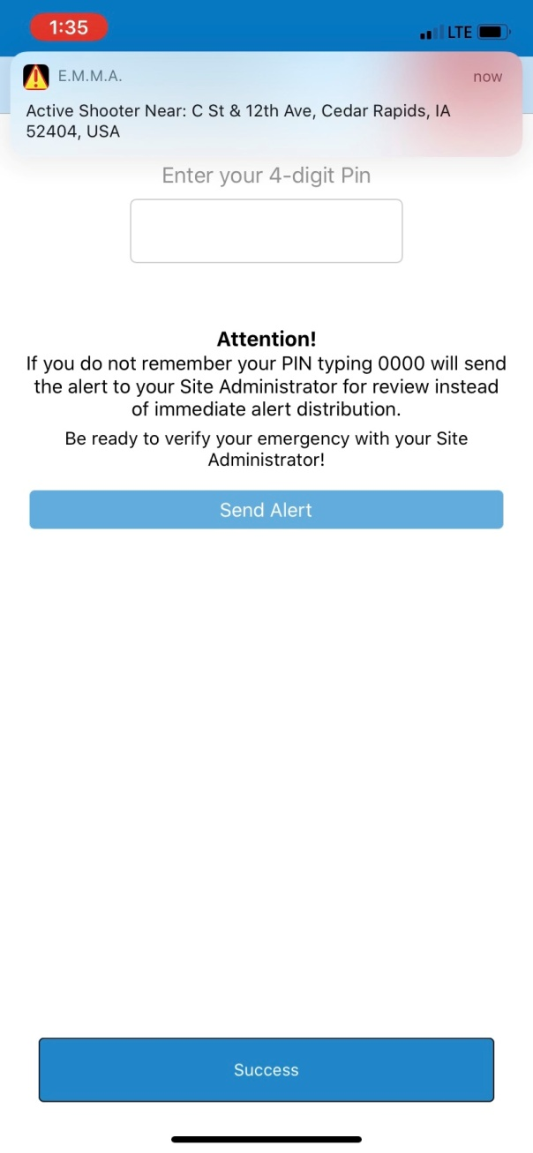
Push Notifications vs SMS?
Push is Faster than SMS/MMS -------
More reliable delivery than SMS/MMS during mass events -------
Text/SMS can ‘stack’ in cell towers during high volumes
Push Notifications similar to Amber Alerts but higher priority
Uses small amount of data vs. Text/SMS/MMS
Appear at the top or middle of your phone screen – depending on phone settings (looks like any notification banner and banner can be customized)
Can be ‘persistent’ or ‘permanent’ based on phone settings and can have custom AUDIO sound
EMMA CAN DELIVER ANY FORMAT
* Email * Phone/TTY/Vmail *Text/SMS

Slide 11
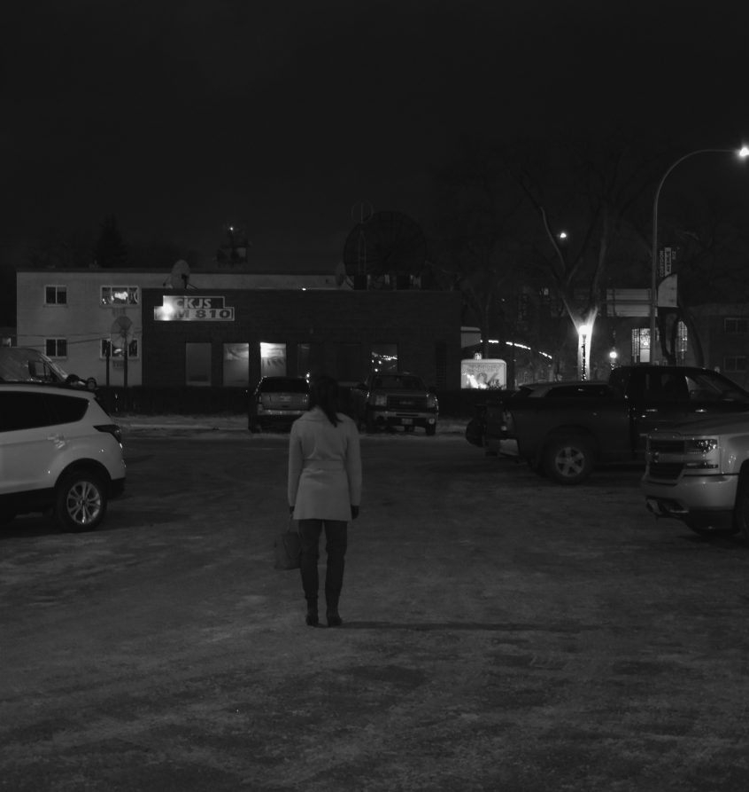
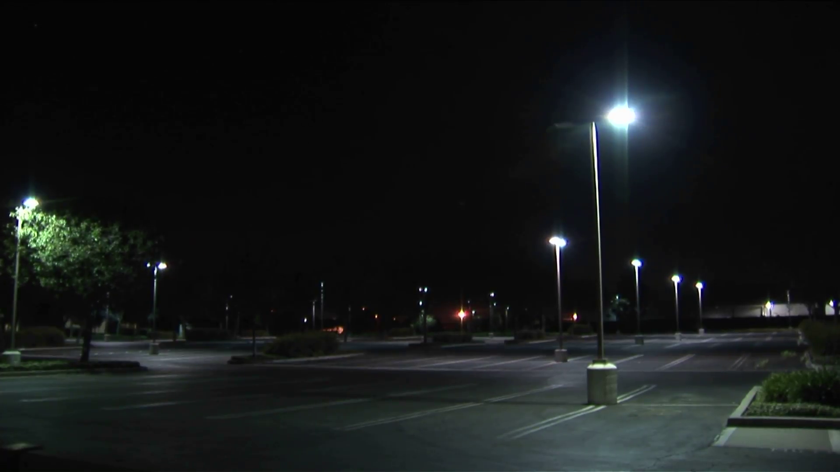
S.O.S. Personal Safety Feature

Slide 12
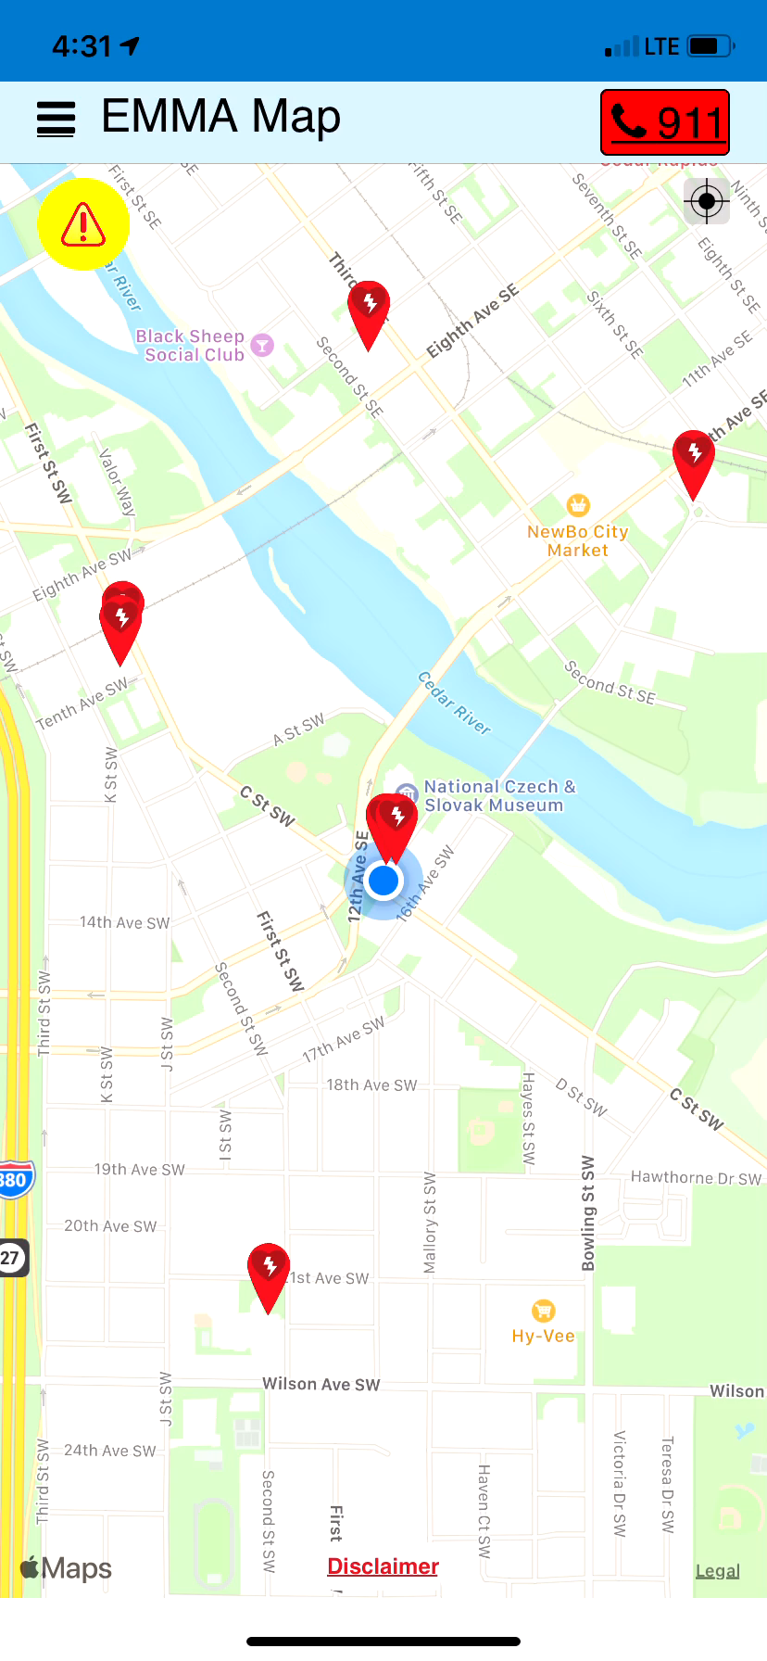
Personal Safety S.O.S. Feature
Press Play icon to see video

Slide 13
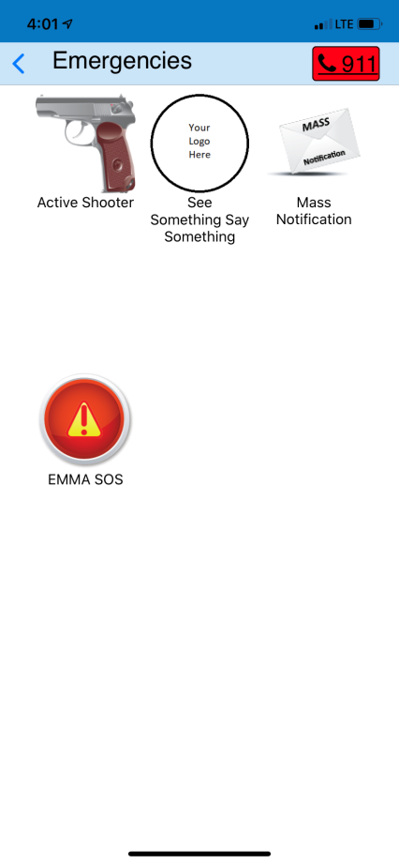
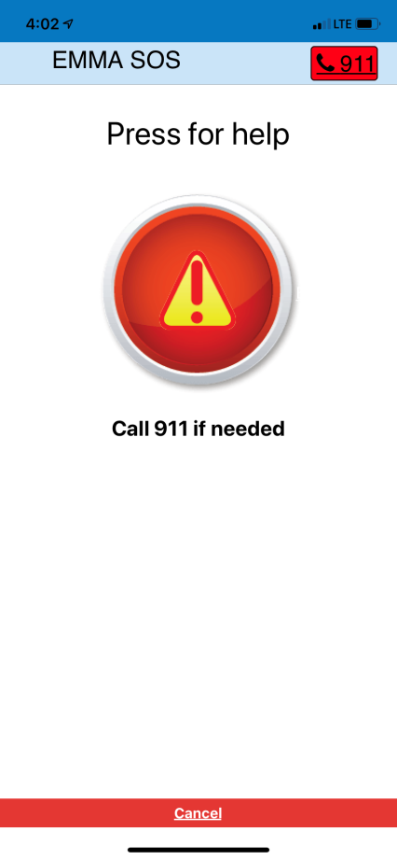
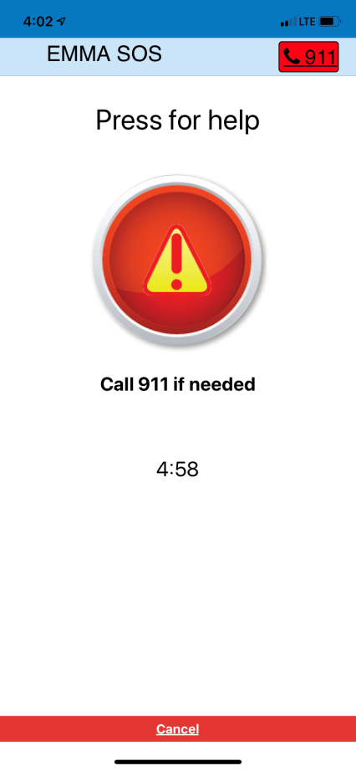
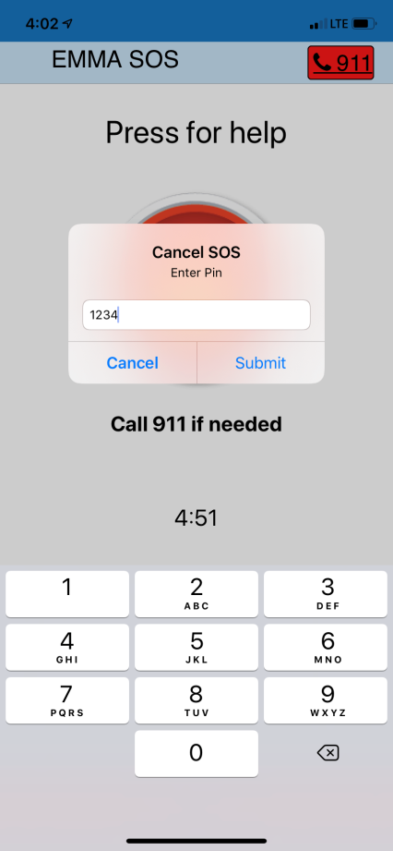
S.O.S. Feature
MINIMAL STEPS TO IMPROVE CAMPUS OR SITE SAFETY!

Slide 14
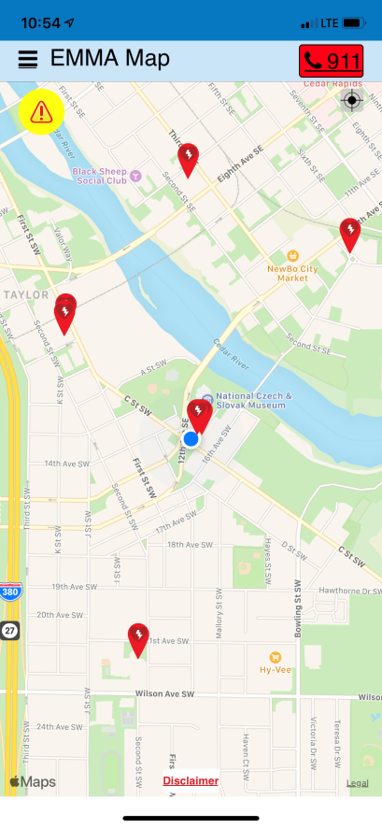

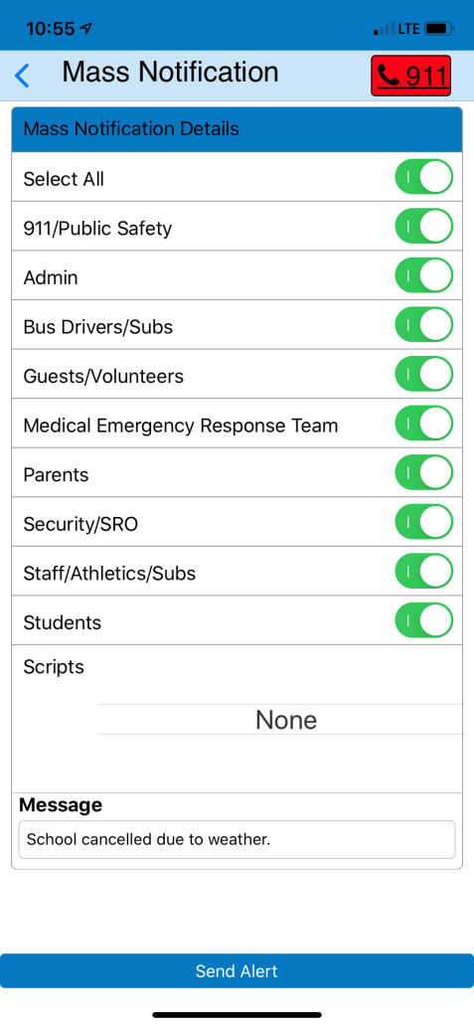
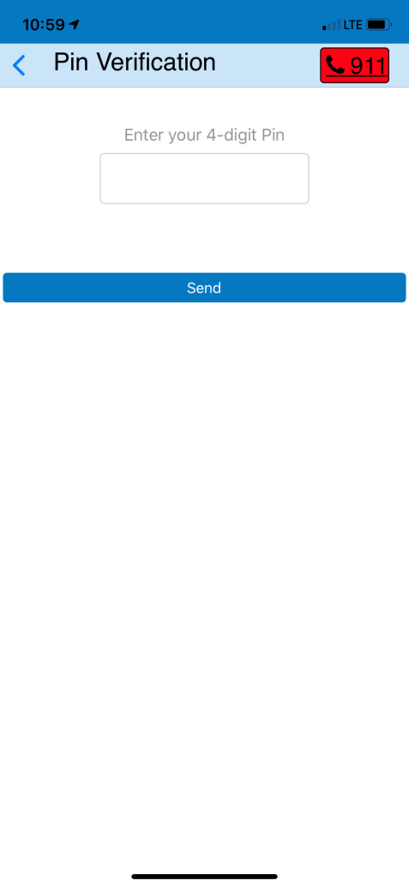
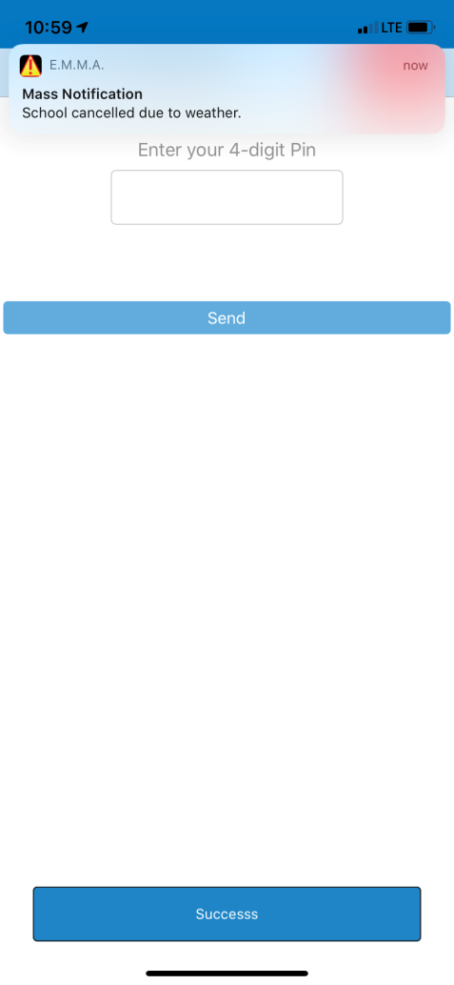
Mass Notifications
NOTE: YOU CAN ALSO TURN ON RESPONSES – key feature!

Slide 15
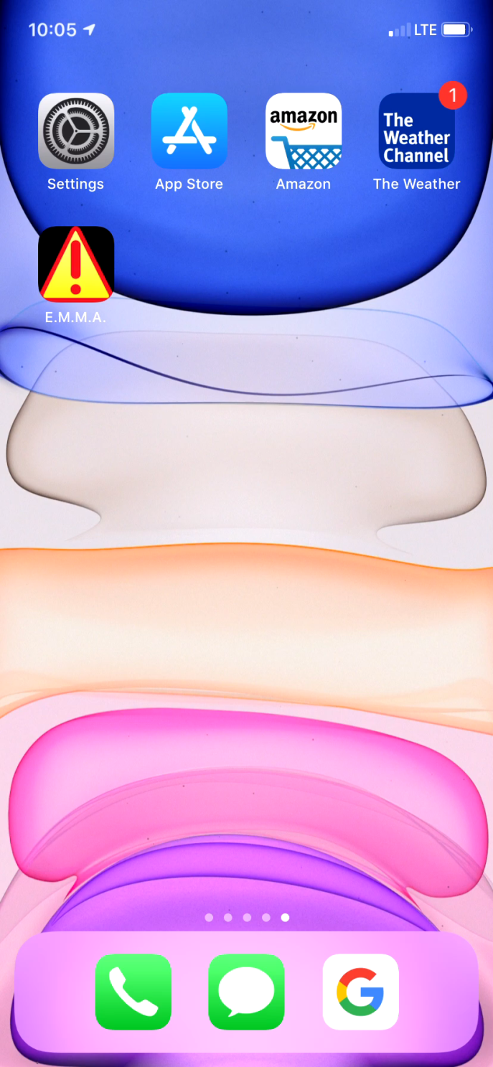
Mass Notifications
<60 seconds
Press Play icon to see video

Slide 16
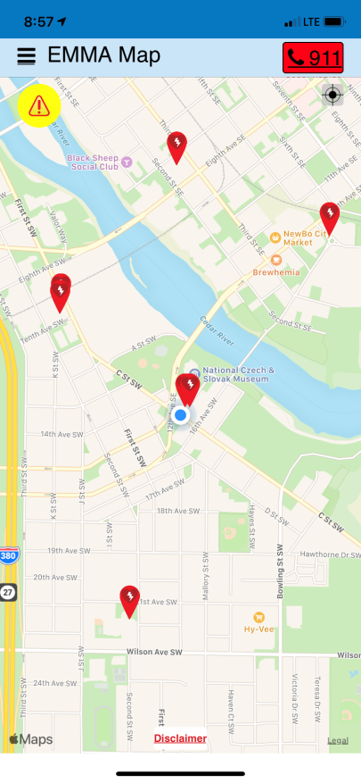

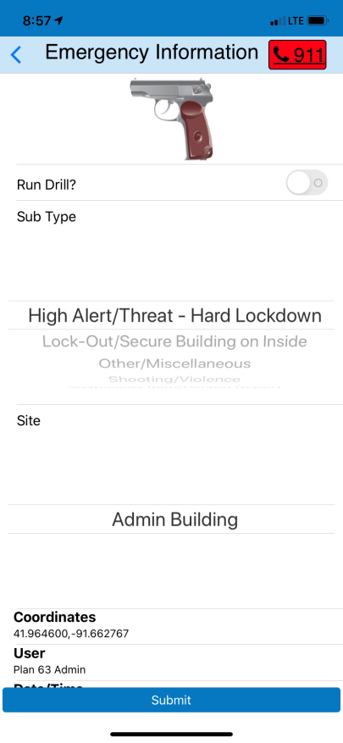
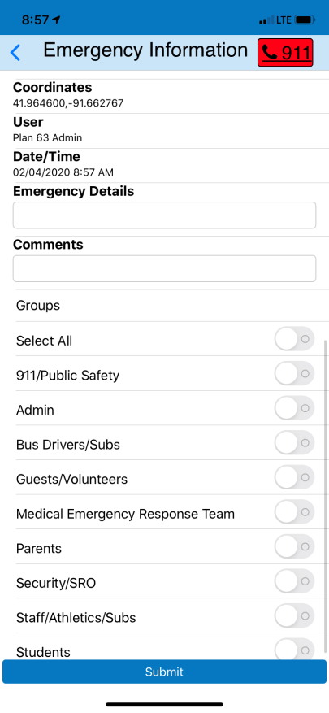
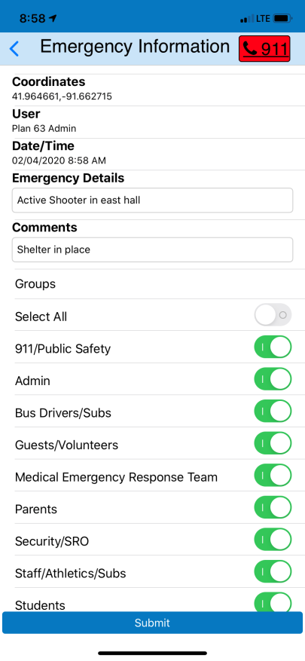
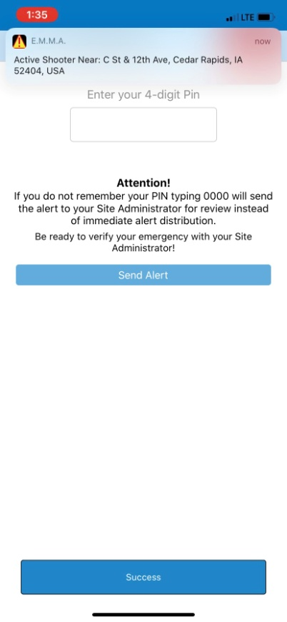
Active Shooter Alerts
NOTE: can have a 911 “On Call” public safety group so even off duty
law enforcement can show up as quick as possible if nearby!

Slide 17
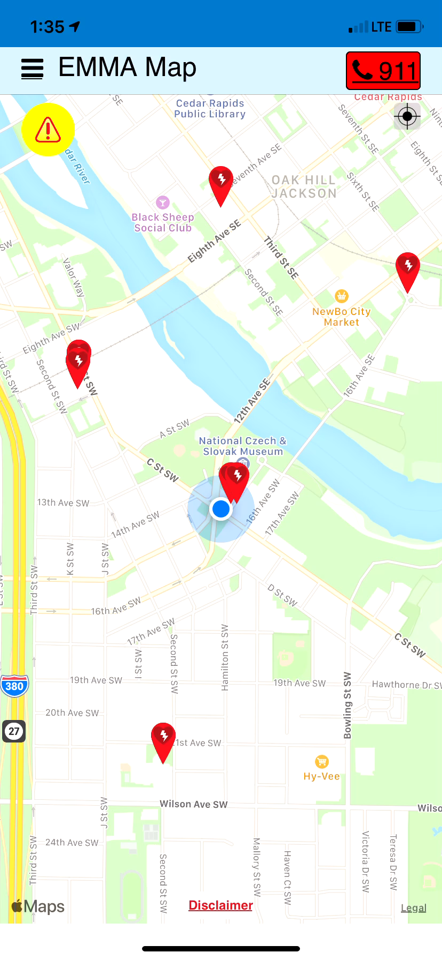
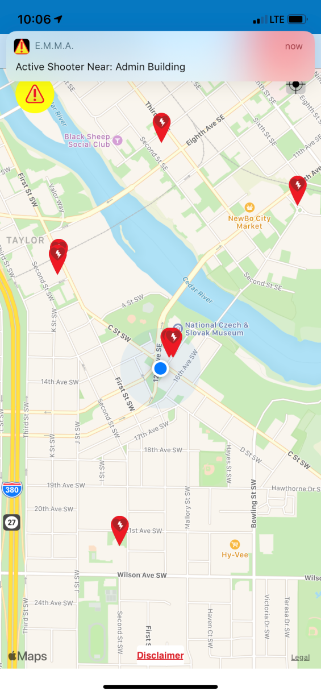
Sending Alert for Active Shooter
Press Play icon to see video

Slide 18
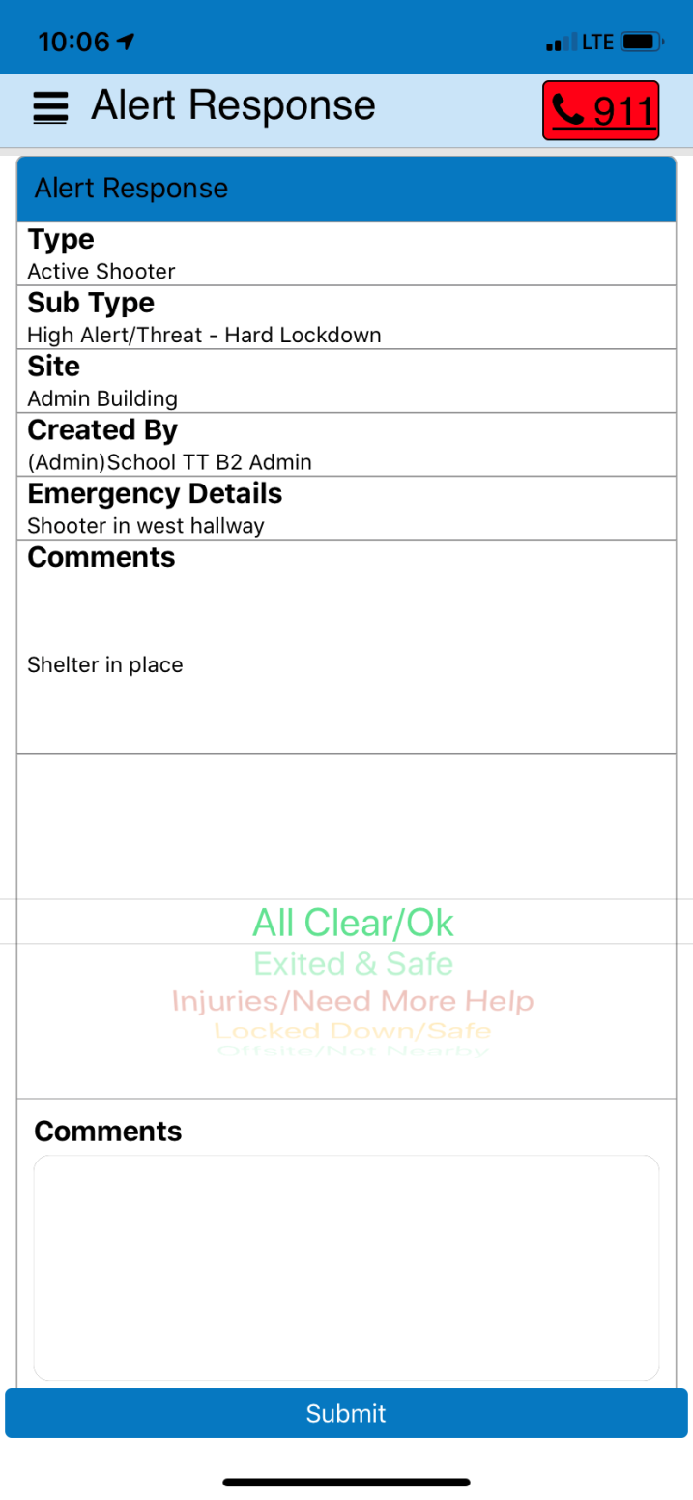
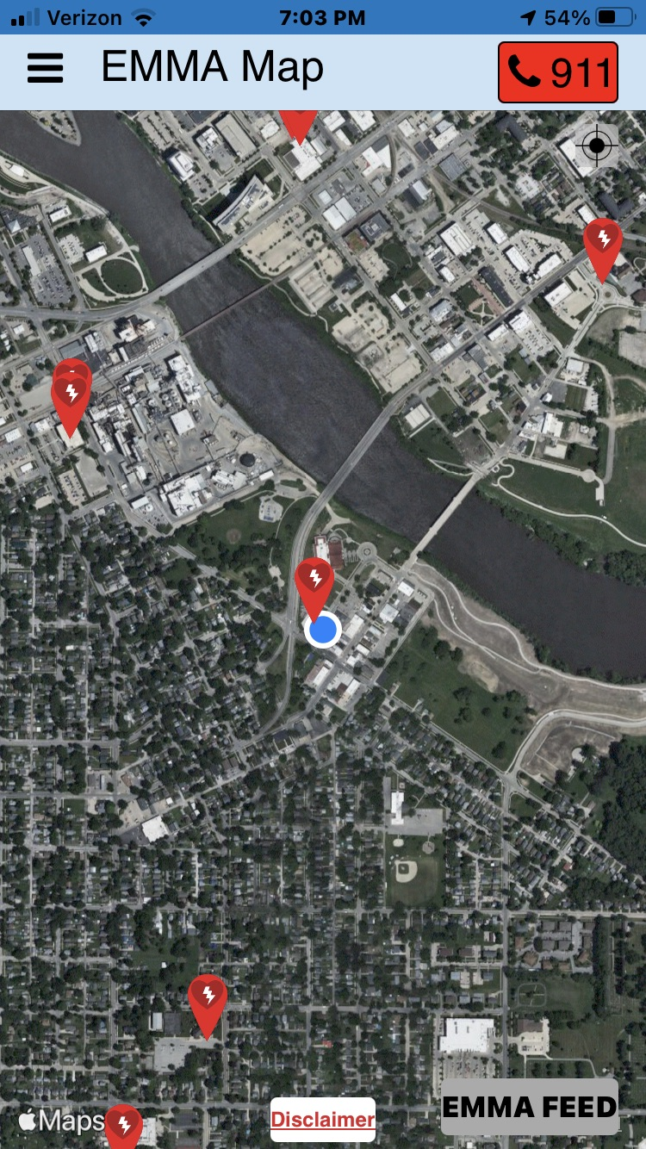
2-Way Communication:
User Response
IMPROVES
Outcomes!
EMMA Users see key chatter
in EMMA FEED that is viewed
by rights & privileges assigned
users at setup

Slide 19
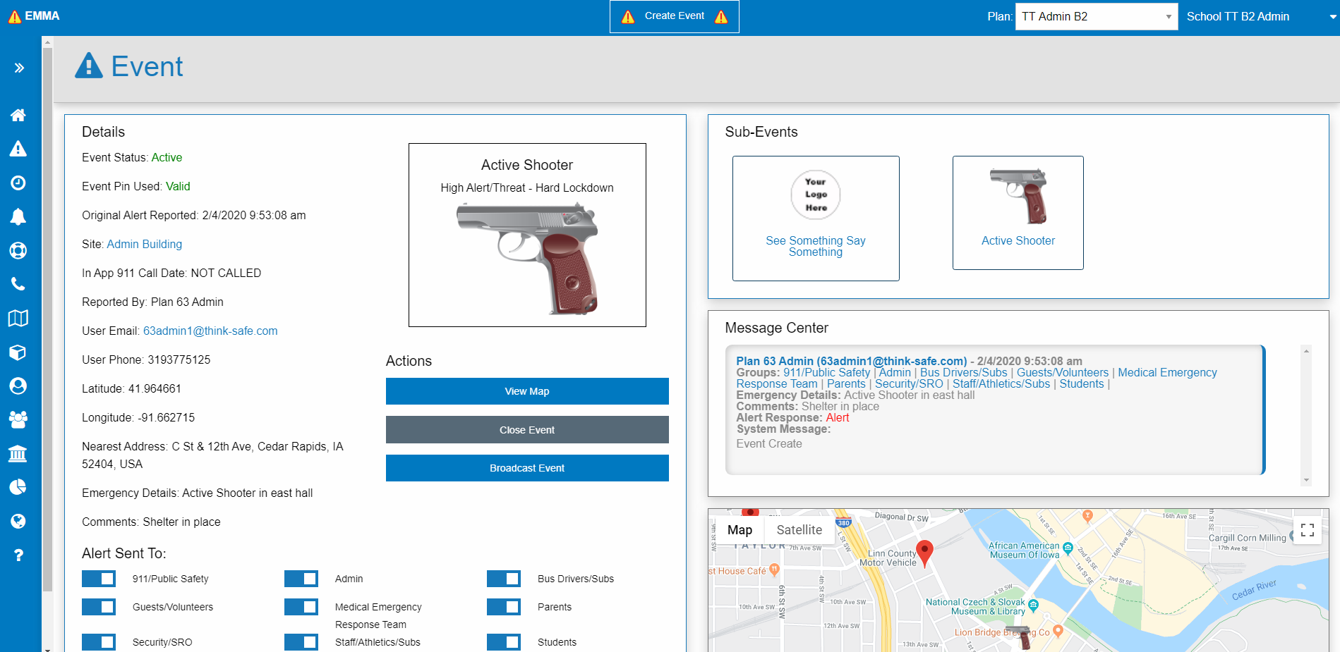
EMMA Admin (www.emmaadmin.com
Site Admin Management Panel – Useful for Incident Command Before & as 911 Arrives
= EMMA FEED for Admins

Slide 20
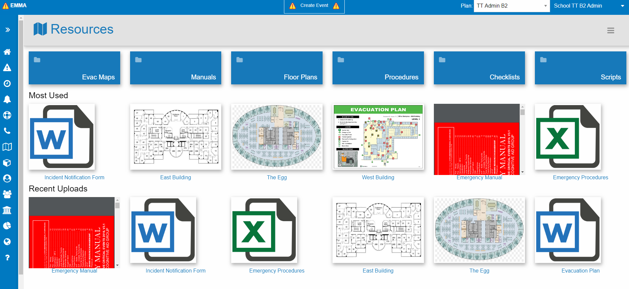
911 & Admins Accessibility to
Quick View Resources
Management Panel – Useful for Incident Command Upon “911 arrival”

Slide 21
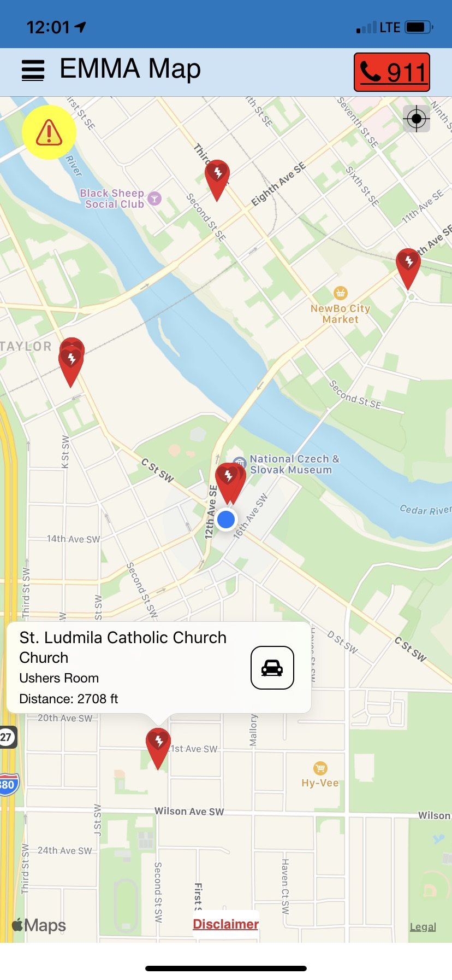

PLUS:
Asset Mapping
Sudden Cardiac Arrest Stats:
Where are AEDs?
Register your lifesaving assets as a free value-add!
Register any asset (assign your own icon to stop bleed kits, emergency call stations, blood donation centers, and more)
Source: Parent Heart Watch

Slide 22
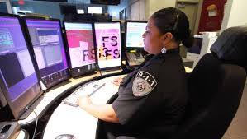
911 Integration – BETTER RESPONSE TIMES
Offers delivery of alerts to public safety in 1/10 of a second without delays plus CAD panel
Identifies and gives visibility to ‘hot spots’ on the map/within a specific area
Provides 911 dispatch latitude and longitude of emergency alerts/events and texts 911 dispatch automatically with plan setup, upon request
Provides incident command ability to 2-Way communicate inside CAD but in EMMA too
  To people in need
  With school crisis response team leaders & EMMA Admins
What system(s)/company does your local CAD 911 dispatch use?
They can use EMMA Admin / EMMA App and more…
We have API & can integrate into 911 dispatch panel
Can send text and/or send/receive alerts from CAD panel
We have in-house Development Team & experience

Slide 23
E.M.M.A. – USE Text to 911
Information sent to 911 (and databased in the EMMA Admin Panel under LOCKDOWN!):
User Name (First Name, Last Name)
User Email
User Title
User Type of EMMA Application In Use (EMMA Mobile App)
User’s LOCKDOWN button press Latitude and Longitude (when MOBILE / GPS location services turned on)
Cell Phone # of User
Landline # of User (if desired)
Date of Alert and Time of Alert (military time)
EMMA User’s PLAN Name (Org = Putnam County School District – XXX Sub-plan)
User Rights/Privileges (Admin or Staff/Base user)
Other ____________________ (must be specified by 911 dispatch center/ approved by Client (School District for example) and likely will include a general message to remind 911 dispatcher team what to do and who the call at Superintendent’s office and what procedures to follow for next steps by dispatch 911 center)

Slide 24


Just send an email to EMMA
– EMMA can alert for you!
1) Send your message by email
2) Received by EMMA secure server
3) Your message instantly distributed by:
Push Notification
Text
Email
Phone/ Robocall
PC
Mac
Chromebook
Social Media
EMMA’s primary method of notification is via Push Notification.
The reason is simple – Push Notification is the fastest most reliable method.
For redundancy, your emergency messages will be delivered by 7 additional methods. This ensures your urgent/emergency message is received. This is also a way to communicate with non-mobile users.

Slide 25
E.M.M.A. - 911 Inclusion Wrap Up
Next steps and plan of action:
  Identify your Goals for Alerts, Communication, Emergency Management
  Thorough demonstration over Zoom/Teams
  Quote / Proposal with or without 911 integration?
Thank you for your time.
PARTNER LOGO HERE:

